Slide 1
Instagram User Analytics
A Project report on users interaction and engagement

Slide 2
Project Description
The craze of using Instagram app is increasing as the days are passing. In this project we are analysing the data of Instagram app users about how they engage and interact with the product (software or mobile application).
This project helps to analyse the raw data/metadata in order to derive business insights for marketing, product & development teams.
These insights are then used by teams across the business to launch a new marketing campaign, decide on features to build for an app, track the success of the app by measuring user engagement.
It helps us to increase efficiency of the platform and improve the experience altogether while helping the business grow.

Slide 3
Approach
First of all, we create a database in SQL in our local machine using the dataset provided.
After checking the data, a quick understanding of dataset was developed.
Finally, using various data extraction, grouping and sorting queries, various insights are generated which are required for our analysis.

Slide 4

Tech-Stack Used
MySQL Workbench v8.0.32
was used as a query tool,
to query the database.

Slide 5
Projects Insights

Slide 6
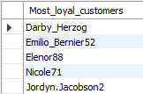
Q1. Rewarding Most Loyal Users People who have been using the platform for the longest time
Result
Task:- Find the 5 oldest users of the Instagram from the database provided.
Query:-
SELECT username AS Most_loyal_customers FROM users ORDER BY created_at LIMIT 5;

Slide 7
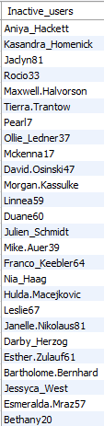
Q2. Remind Inactive Users to Start Posting By sending them promotional emails to post their 1st photo
Result
Task:- Find the users who have never posted a single photo on Instagram.
Query:-
SELECT username AS Inactive_users FROM users WHERE id NOT IN (SELECT user_id FROM photos);

Slide 8


Q3. Declaring Contest Winner The team started a contest and the user who gets the most likes on a single photo will win the contest now they wish to declare the winner.
Task:- Identify the winner of the contest and provide their details to the team
Query:-
SELECT username AS Inactive_users FROM users WHERE id NOT IN (SELECT user_id FROM photos);

Slide 9
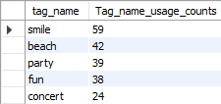
Q4. Hashtag Researching A partner brand wants to know, which hashtags to use in the post to reach the most people on the platform
Task:- Identify and suggest the top 5 most commonly used hashtags on the platform
Query:-
SELECT tag_name, COUNT(tag_id) AS Tag_name_usage_counts FROM tags
LEFT JOIN photo_tags
ON photo_tags.tag_id = tags.id
GROUP BY tag_name
ORDER BY Tag_name_usage_counts DESC LIMIT 5;
Result

Slide 10
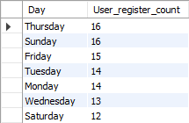
Q5. Launch AD Campaign The team wants to know, which day would be the best day to launch ADs
Task:- What day of the week do most users register on? Provide insights on when to schedule an ad campaign
Query:-
SELECT DAYNAME(created_at) AS Day,
COUNT(*) AS User_register_count
FROM users GROUP BY Day
ORDER BY User_register_count DESC;
Result

Slide 11
Investor Metrics

Slide 12

Q1. User Engagement Are users still as active and post on Instagram or they are making fewer posts
Task:- Provide how many times does average user posts on Instagram. Also, provide the total number of photos on Instagram/total number of users
Query:-
SELECT username AS Inactive_users FROM users WHERE id NOT IN (SELECT user_id FROM photos);

Slide 13
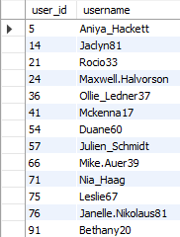
Q2. Bots & Fake Accounts The investors want to know if the platform is crowded with fake and dummy accounts.
Result
Task:- Provide data on users (bots) who have liked every single photo on the site (since any normal user would not be able to do this)
Query:-
SELECT ROUND((SELECT COUNT(*) FROM photos) /
(SELECT COUNT(*) FROM users),2)
AS Average_users_posts;

Slide 14
Result
I successfully analyzed dataset of Instagram user data using advanced data analysis techniques. This allowed me to identify patterns and trends in user behavior and engagement that were previously unknown.
Overall, this project has been a highly rewarding experience that has helped me to develop a wide range of skills and knowledge.
Through this project, I have gained valuable experience in data analysis, data visualization, and problem-solving, and I look forward to applying these skills in future projects and opportunities.

